Slide 1
Admission Analysis
Professor
Dr. Sarika Rajeev
DATA – 604
Team Project

Slide 2
Team Members
01
02
03
04
Ashutosh Joshi
Adil Mohammad
AH31139
AQ58890
Rahul Kaushik Mallela
Rohith KumarKoutike
OO29854
VA74657

Slide 3

Introduction
Dataset contains information on factors important for admissions to graduate schools in the US.
Columns include GRE score, TOEFL score, university rating (tiers), SOP score, LOR score, CGPA, and research experience score.
Helps students predict their chances of being accepted into a graduate school.
Useful for students considering applying to graduate schools in the US.
Provides a comprehensive view of factors influencing admission decisions for graduate schools.

Slide 4



Tools Needed and Used
SPARK SQL
Python
AWS

Slide 5
Data Collection
Surveys: Directly collect information from graduate school applicants through questions related to their academic performance, scores, and university choices.
University data: Collect data from universities on their graduate program ratings and applicant scores and experience.
Publicly available data: Obtain data on university rankings and admission statistics from public data sources.
Observations: Observe interactions between students and admissions representatives at graduate school fairs and events to gain insights into the admission process.

Slide 6
Data Visualization

Slide 7
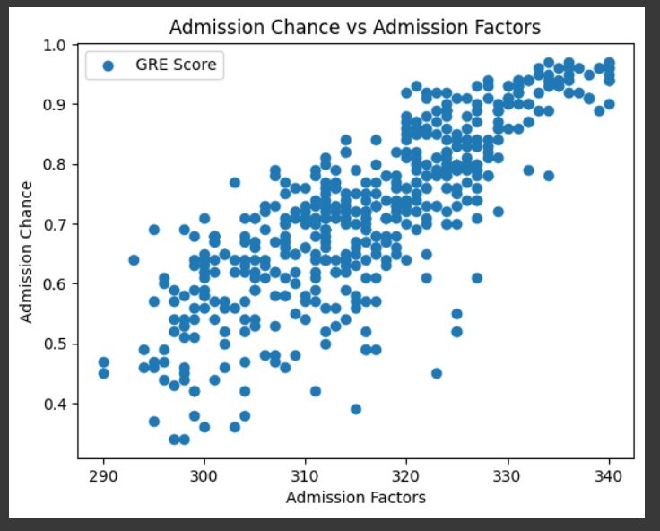
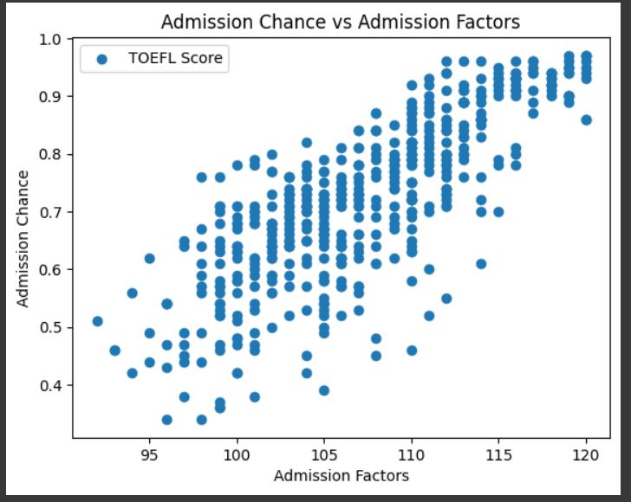
Students Score

Slide 8
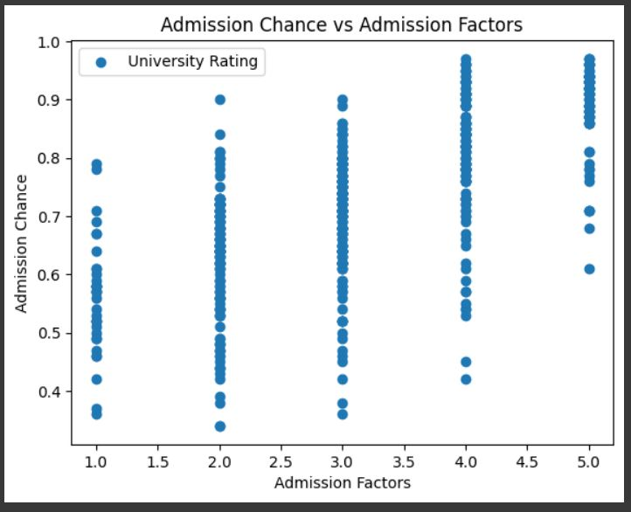
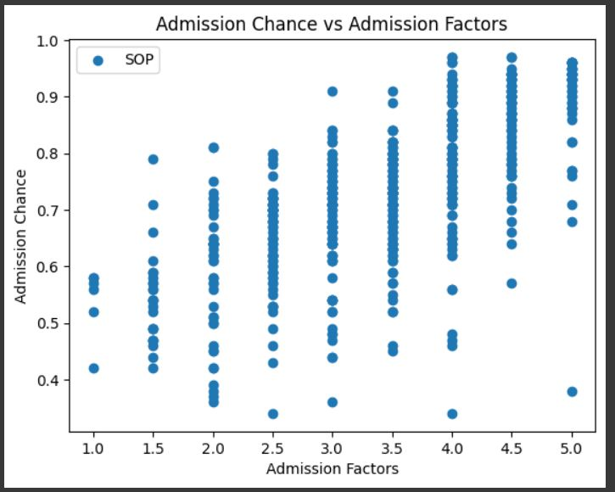
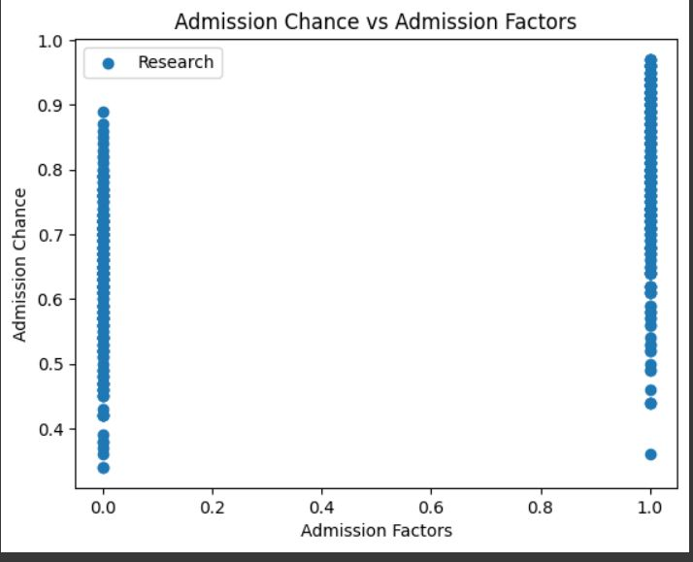
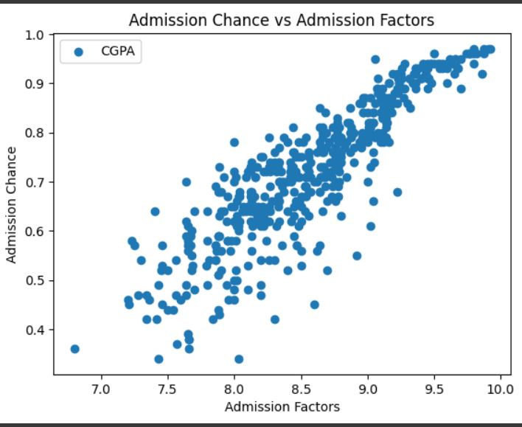
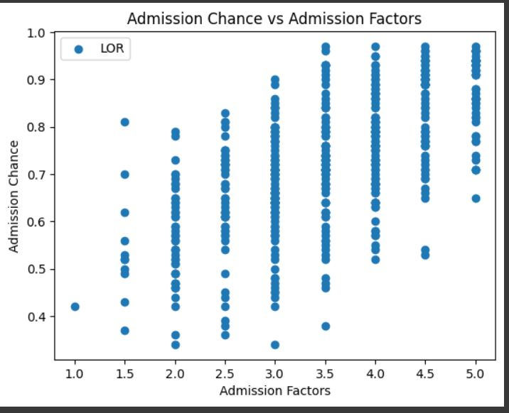

Slide 9
Correlations
Factors | Correlation with Admission Success
GPA | 0.62
LOR Quality | 0.59
Research Experience | 0.41
GRE Score | 0.83
TOEFL Score | 0.45
SOP Quality | 0.25

Slide 10
Application
Student Application
College
Counseling
The dataset can be used by students to predict their chances of getting into a US graduate school and make informed decisions about their applications.
Colleges can use the dataset to analyze the admission factors of their graduate programs and make better-informed admission decisions.
Counseling services can use the dataset to offer personalized guidance to students on how to improve their chances of getting accepted into a graduate school.

Slide 11
Budgeting Predictions
The budget to industrialize this project requires following requisites:
Amazon Web Services:
t2.large 2vCPU, 8 GB RAM, EBS Storage: 36 CPU Cred/ Hour
0.26 $ per hour. Running for a month
=> 0.26 * 24 * 30 = 187.2 $ per month
Maintenance:
100-120 $ per month
Web Hosting:
30-40 $ per year
Total: 187 $ + 110 $ + 5 $ => 302 $ per month
With a budget of under 500 $ per month we can deploy this project in the market.

Slide 12
Conclusion
Machine learning models can be used to predict admission chances for students based on various factors, including GRE and TOEFL scores, university ratings, SOP, LOR, CGPA, and research experience.
Different machine learning models, such as logistic regression, decision trees, and neural networks, can be trained and tested on the dataset to predict admission outcomes.
Potential future applications of this model include providing personalized guidance to students on which universities to apply to based on their admission chances and helping universities optimize their admissions process by identifying the most predictive factors of successful applicants.
Future research can explore fairness and bias implications of using machine learning models for graduate school admissions and how to mitigate potential biases in the models.
Overall, machine learning has the potential to benefit both students and universities by providing more informed decision-making for the admissions process.

Slide 13
References
https://www.topuniversities.com/where-to-study/north-america/united-states/ranked-top-100-us-universities
https://aws.amazon.com/ec2/instance-types/
https://aws.amazon.com/aws-cost-management/
https://spark.apache.org/docs/1.0.2/sql-programming-guide.html

Slide 14
THANK YOU

